Slide 1
Instructions:
Copy Title, Overview, BOM, Components, Schematic and Layout templates (the next 5 slides)
Fill out each slide according to the instructions on the template
You will be presenting your project to the class, so be ready to talk about the material on your slides. We are NOT grading you on your presentation skills, but on CONTENT

Slide 2
Coffee Bean Roaster
TEMPLATE
Carlson Jansen
Andrew Liu
Mirwais Lodin
Liam McHugh

Slide 3
Project Overview and Name ~1 min
TEMPLATE
Our project aims for implementing a functional precision temperature control for equipment like a Coffee Bean Roaster, by recycling simple popcorn maker with built in heater, fan, and AC power distribution.
The project will dive into recreating thermocouple module, AC or DC heat fan dimmer/control board, wall plug AC/DC converter, additional app/GUI control on screen display.
Major challenges would be precise feedback control of temperature in the chamber, additional serial peripheral interface bus may be required if multiple thermocouple is desired.
ESP32, K-Type Thermocouple, 16x4 LCD
Overall circuit designs (filter types, power regulator type, power source, microcontroller used, important sensors, actuators or ICs, data buses used)

Slide 4
BOM ~30 sec
TEMPLATE
Screenshot of BOM, mostly for reference
Use multiple slides if necessary
Point out expensive parts and the total cost per board

Slide 5
Schematic ~2 min
TEMPLATE
Add more slides with zoomed-in detail views DO NOT JUST SHOW A ZOOMED OUT PHOTO OF THE ENTIRE SCHEMATIC
If you do not know the best way to subdivide the schematic for separate screenshots, we recommend breaking it up by circuit category you fulfill for the project requirements
Crop whitespace so schematic fills as much as possible
Make sure image is not low resolution
Box/label sub-blocks if not already done in the schematic

Slide 6
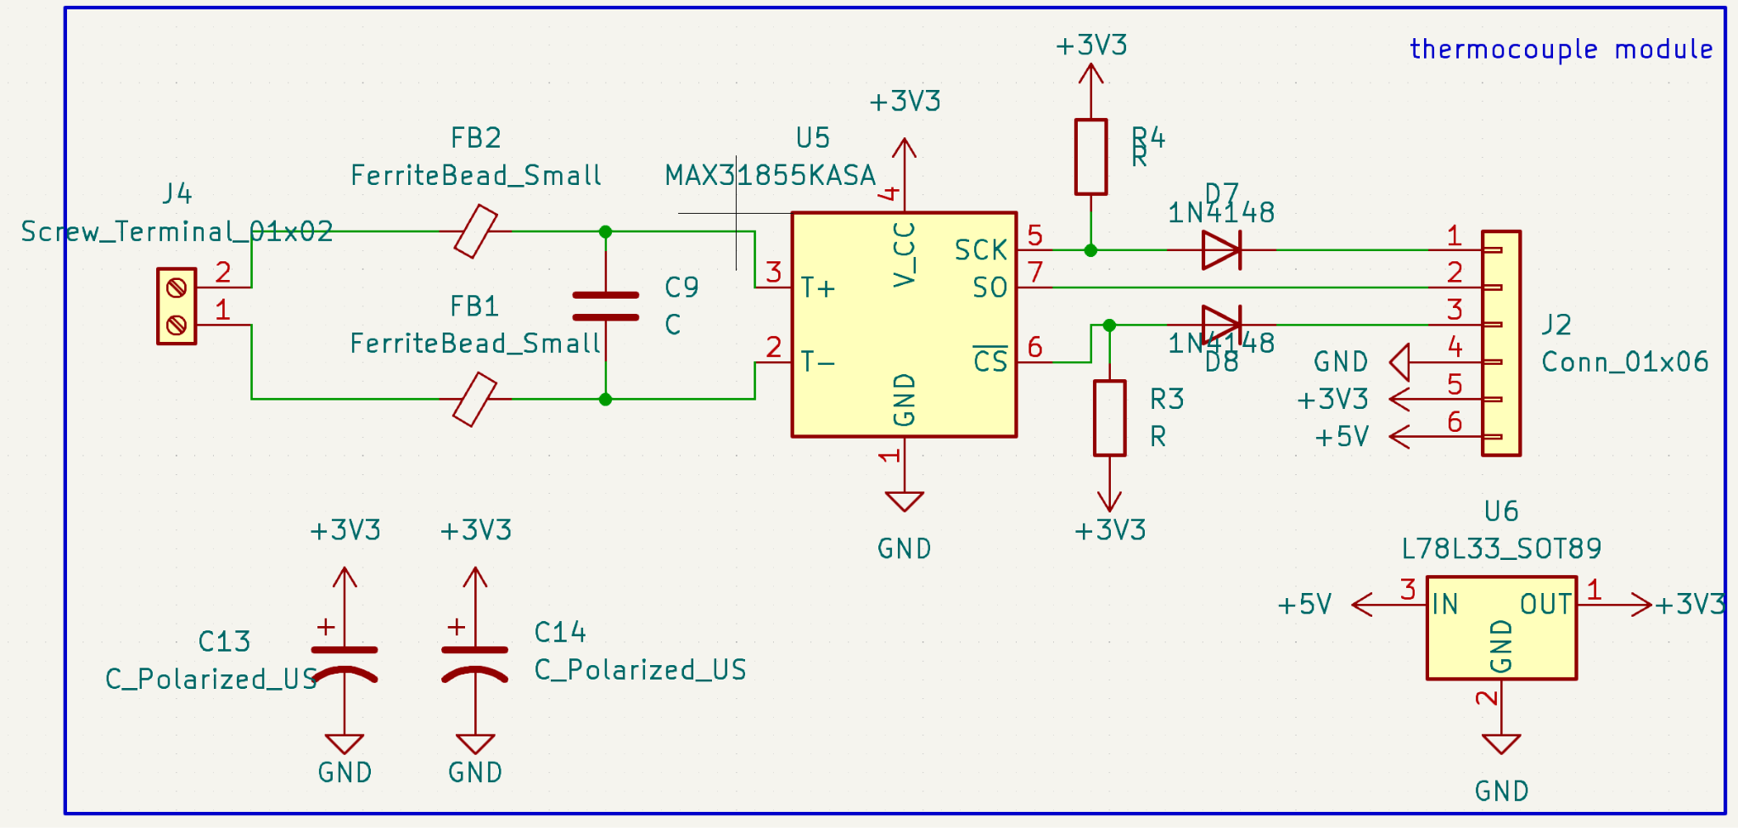

Slide 7
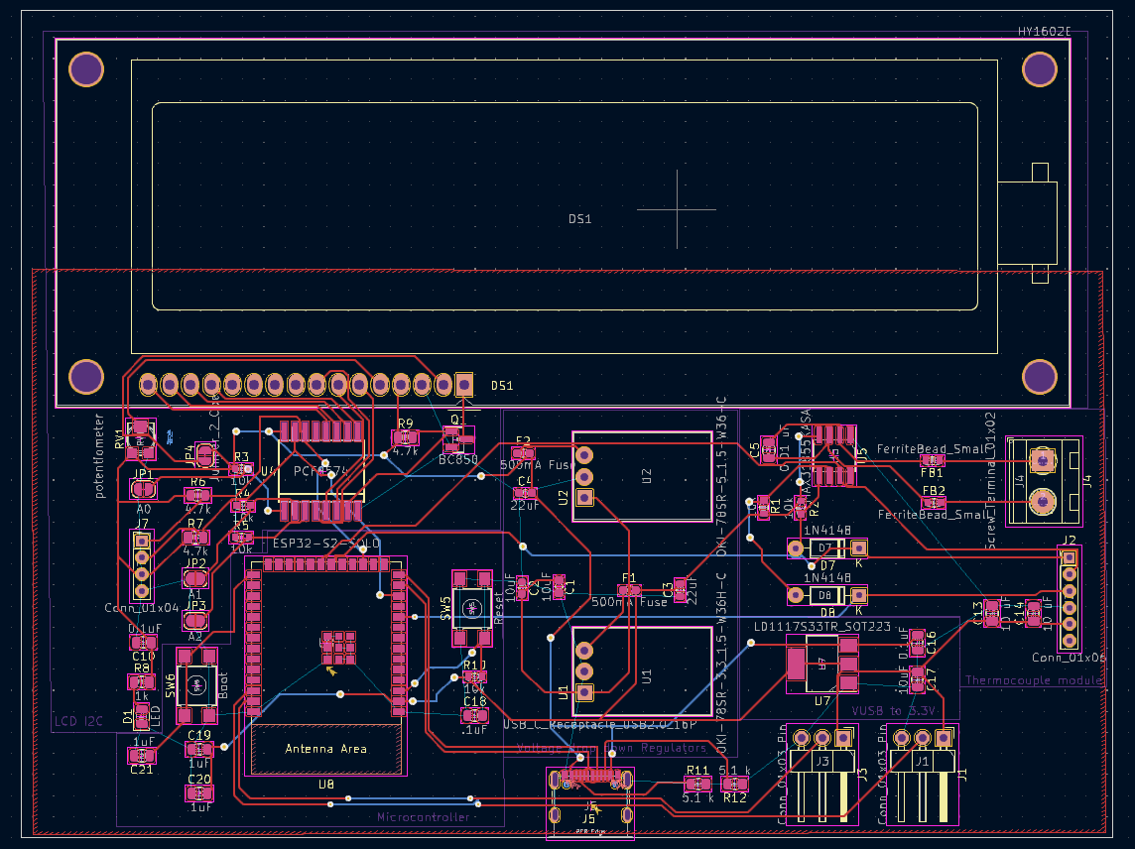

Slide 8
Zoomed In: Thermocouple MAX 31855 module —---------->
VUSB to 3.3V voltage Regulator —---------->
Two 1x3 connector Heater & Fan Relays—------>

Slide 9
Zoomed In: 24V DC to 5V Voltage drop down Reg —>
24V DC to 3.3V Voltage Regulator —>

Slide 10
Zoomed In: ← I2C for LCD
← ESP32 S2 SOLO
USBC connector
I
V

Slide 11
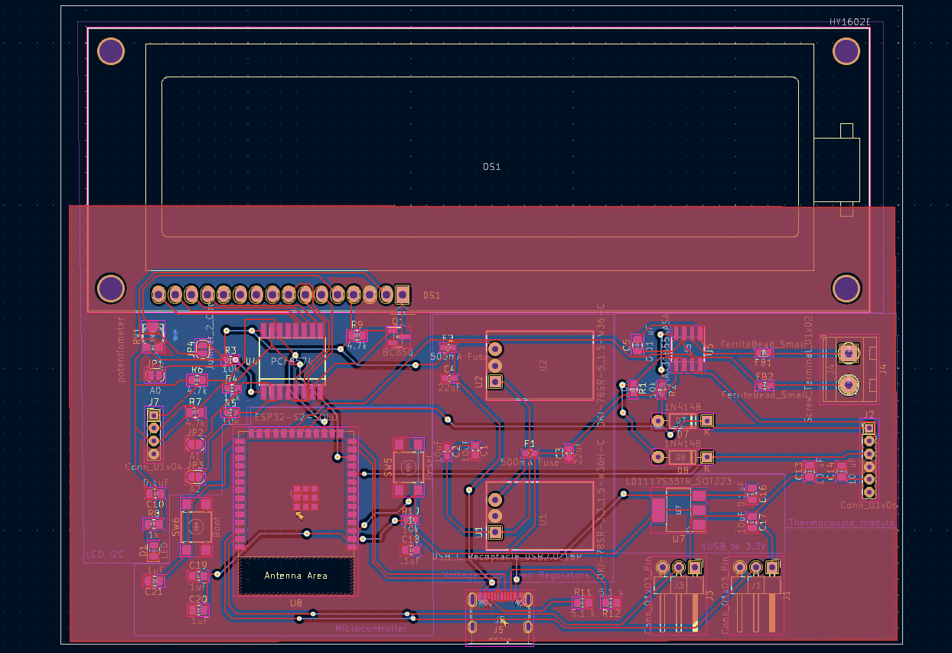

Slide 12
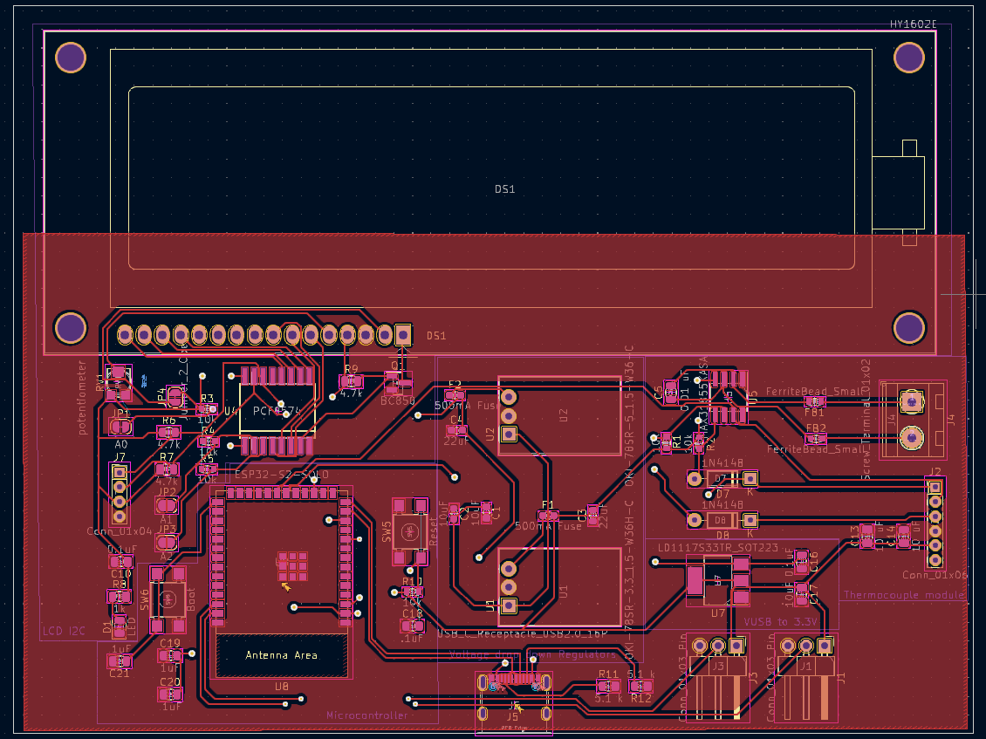

Slide 13
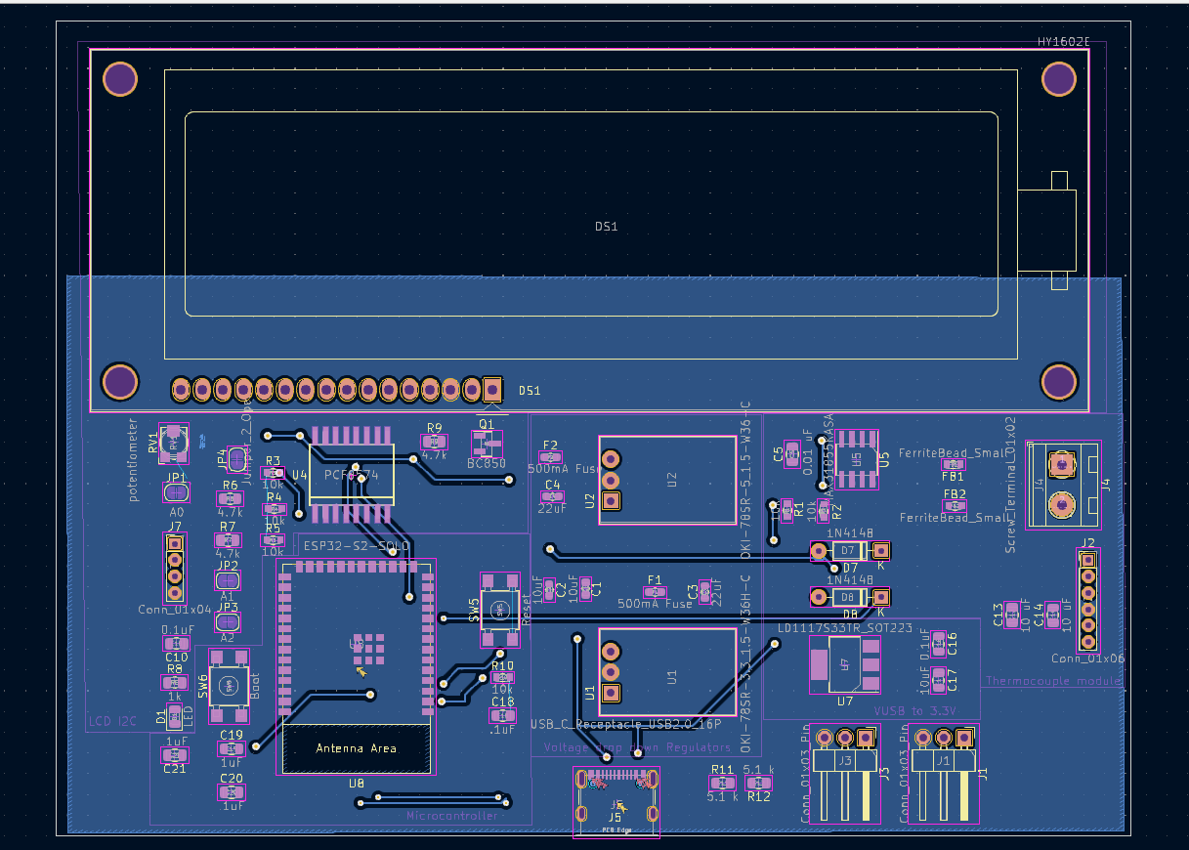

Slide 14
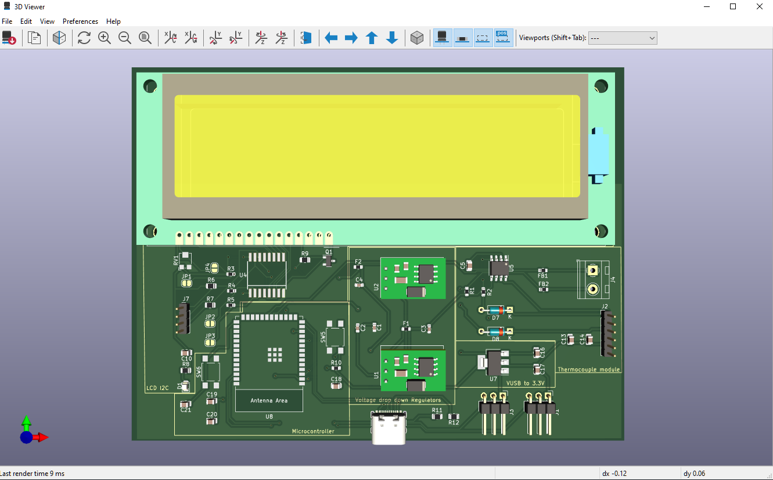

Slide 15
